Slide 1


Computer-Aided Design VHDL Syntax
Mahdi Aminian
Some slides courtesy of:
“Hardware Systems Modeling”, A. Vachoux, EPFL
“VHDL”, Dan Solarek, University of Toledo
CAD slides from Dr. Saheb Zamani

Slide 2
VHDL - Overview
Very High Speed Integrated Circuit Hardware Description Language
Modeling of digital systems
Concurrent and sequential statements
International Standards
IEEE Std 1076-1987
IEEE Std 1076-1993, 2000, 2002, …
علاوه بر استانداردهاي خالص, تلاشهايي براي استاندارد كردن عوامل مربوط به VHDL انجام گرفته است:
پكيج هاي
Std_logic_1164
Numeric_bit
Numeric_std
زيرمجموعة قابل سنتز: استاندارد 1076.6
VHDL-AMS 1076.1

Slide 3
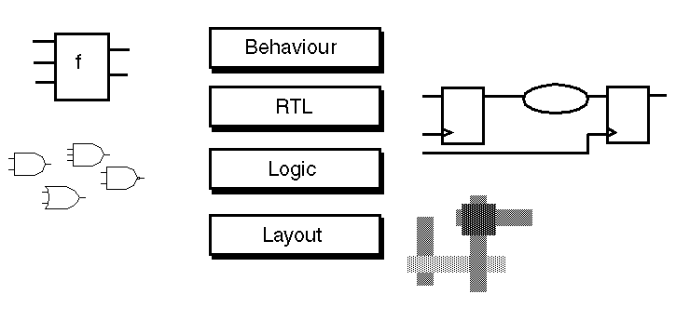
Abstraction Levels in IC Design
VHDL براي سطح layoutمناسب نيست.

Slide 4
VHDL Structural Elements
Entity: Interface
Architecture: Implementation, behavior
Configuration: Structure, hierarchy
Process: Sequential Execution
Package: Components (Modular design), Utilities (data types, constants, subprograms)
Library: Group of compiled units, object code

Slide 5
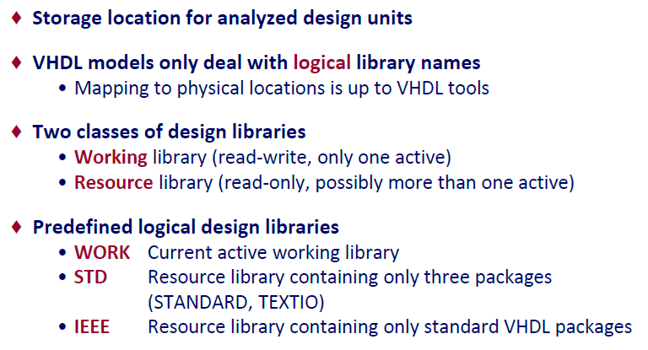
Design Library

Slide 6
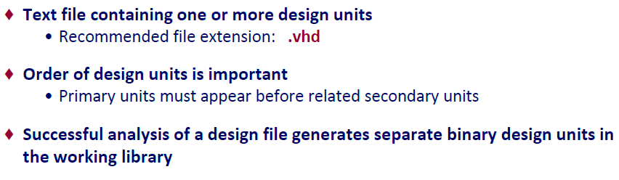
Design File

Slide 7
VHDL Key Idea
A key idea in VHDL is to define the interface of a hardware module while hiding its internal details.
A VHDL entity is simply a declaration of a module’s inputs and outputs, i.e., its external interface signals or ports.
A VHDL architecture is a detailed description of the module’s internal structure or behavior.
entity
interface
interface
architecture

Slide 8
VHDL Interface - Ports
You can think of the entity as a “wrapper” for the architecture
hiding the details of what’s inside
providing “ports” to other modules
entity
.
.
.
.
.
.
output port
architecture

Slide 9
VHDL Conceptual Model
VHDL actually allows you to define multiple architectures for a single entity
it also provides a configuration management facility that allows you to specify which architecture to use during a particular synthesis run
entity
architecture 1
architecture 2
configuration

Slide 10
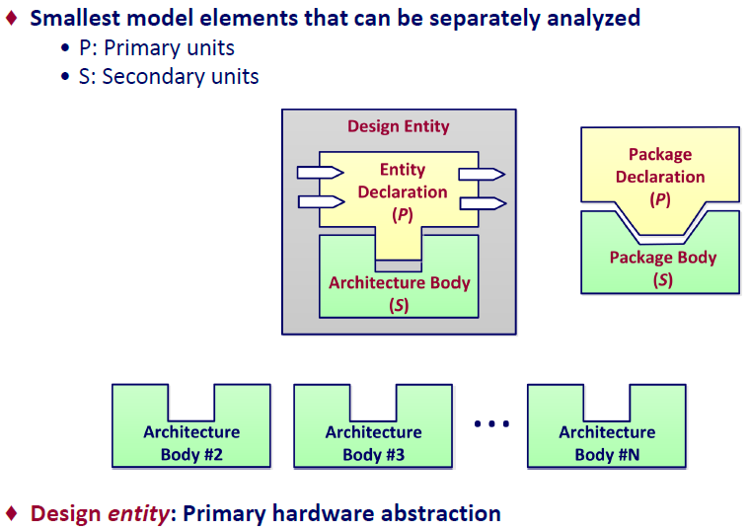
VHDL Design Units

Slide 11

Entity
entity HALFADDER is port( A, B: in bit; SUM, CARRY: out bit); end entity HALFADDER;
Interface description
No behavior/implementation definition
entity ADDER is port( A, B: in integer range 15 to 0; SUM: out integer range 15 to 0; CARRY: out bit ); end ADDER;
in bit_vector (3 downto 0); out bit_vector (3 downto 0);
Linking via port signals
data types
signal width
signal direction

Slide 12
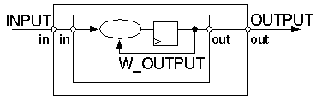
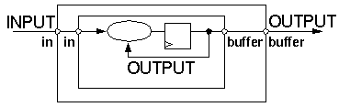
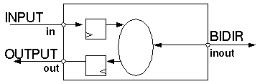
Entity Port Modes
in:
signal values are read-only
out:
signal values are write-only
multiple drivers
buffer:
similar to out
signal values may be read, as well
only 1 driver
inout:
bidirectional port

Slide 13
General
---------------------------------- -- Example VHDL Code -- ---------------------------------- signal mySignal: bit; -- an example signal MYsignal <= '0', -- start with '0' '1' AFTER 10 ns, -- and toggle after '0' after 20 ns, -- every 10 ns '1' afTer 30 ns;
Statements are terminated by ';' (may span multiple lines)
List delimiter: ','
Signal assignment: '<='
User defined names:
letters, numbers, underscores
start with a letter
Comments: '--' until end of line

Slide 14
VHDL Identifiers (Names)
Basic identifier
starts with a letter
made up of letters, numbers, and underscore “_” character
cannot end with an underscore
case-insensitive: MY_Signal_Name = my_signal_name
Extended Identifier
any text within 2 backslashes
e.g., \2FOR$\ \-23signal\ etc.
case is significant: \COUNT\ not equal to \count\, and \FRAMUS\ not equal to basic identifier FRAMUS
Not often used – not necessarily supported in synthesis !!
not recommended

Slide 15
Identifiers
mySignal_23 -- normal identifier rdy, RDY, Rdy -- identical identifiers vector_&_vector -- X : special character last of Zout -- X : white spaces idle__state -- X : consecutive underscores 24th_signal -- X : begins with a numeral open, register -- X : VHDL keywords
(Normal) Identifier
Letters, numerals, underscores
\mySignal_23\ -- extended identifier \rdy\, \RDY\, \Rdy\ -- different identifiers \vector_&_vector\ -- legal \last of Zout\ -- legal \idle__state\ -- legal \24th_signal\ -- legal \open\, \register\ -- legal
Extended Identifier:
Enclosed in back slashes
Case sensitive
Graphical characters allowed
May contain spaces and consecutive underscores
VHDL keywords allowed

Slide 16

Architecture
entity HALFADDER is port( A, B: in bit; SUM, CARRY: out bit); end HALFADDER; architecture RTL of HALFADDER is begin SUM <= A xor B; CARRY <= A and B; end architecture RTL;
Implementation of the design
Always connected with a specific entity
one entity can have several architectures
entity ports are available as signals within the architecture
Contains concurrent statements

Slide 17
Architecture Structure
architecture EXAMPLE of STRUCTURE is subtype DIGIT is integer range 0 to 9; constant BASE: integer := 10; signal DIGIT_A, DIGIT_B: DIGIT; signal CARRY: DIGIT;
begin DIGIT_A <= 3; SUM <= DIGIT_A + DIGIT_B; DIGIT_B <= 7; CARRY <= 0 when SUM < BASE else 1; end EXAMPLE ;
Declarative part:
data types
constants
intermediate signals
component declarations
...
Statement part (after 'begin'):
signal assignments
processes
component instantiations
concurrent statements: order not important
→ Simulator recalculates sum any time an operand changes
Port is a kind of signal.

Slide 18
Four Classes of Data Objects
Constant
Holds a single value of a given type – cannot change.
Signal
Holds a LIST of values of a given type.
Present value + a set of possible future values
New values can be assigned at some future time – not now!
Signals have ATTRIBUTES: [signal’attribute]
Variable
Holds a single value of a given type.
New value of same type can be “assigned” – (instantly)
File
Contains a sequence of values of one or more types.
Usually read or written to using procedures
For simulation – not synthesis
analogous to a “wire”

Slide 19
Data Types
Scalar Types
Enumerated : a list of values
Integer
Floating Point
Physical : with units, for physical quantities
Composite Types
Array (all of same type)
Record (can be different types)
Access Type
File Type

Slide 20
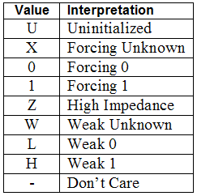
Enumerated Types
CHARACTER – one of the ASCII set
BOOLEAN – can be FALSE or TRUE
BIT – can be ‘0’ or ‘1’ (note single quotes)
STD_LOGIC
Has NINE legal values:
‘U’, ‘X’, ‘0’, ‘1’, ‘Z’, ‘W’, ‘L’, ‘H’, ‘-’
Example Declarations
Type CAR_STATE is (back, stop, slow, medium, fast);
Subtype GO_KART is CAR_STATE range stop to medium;
Type DIGIT is (‘0’, ‘1’, ‘2’, ‘3’, ‘4’, ‘5’, ‘6’, ‘7’, ‘8’, ‘9’ );
IEEE std_logic_1164 package

Slide 21

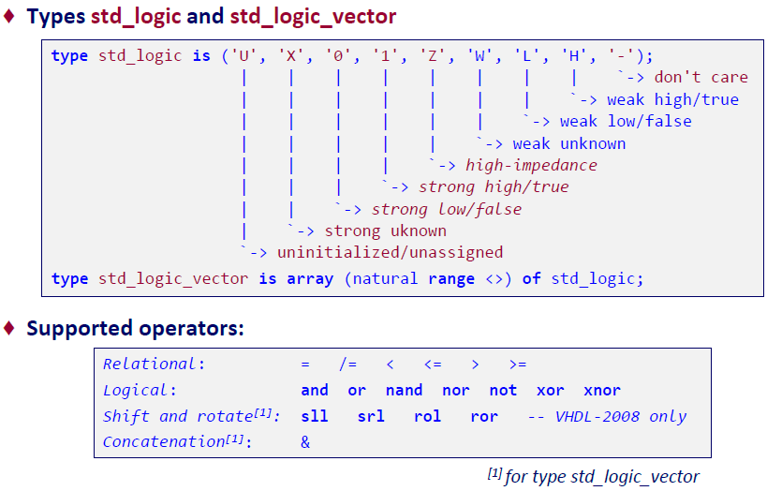
Logic Data Representation

Slide 22
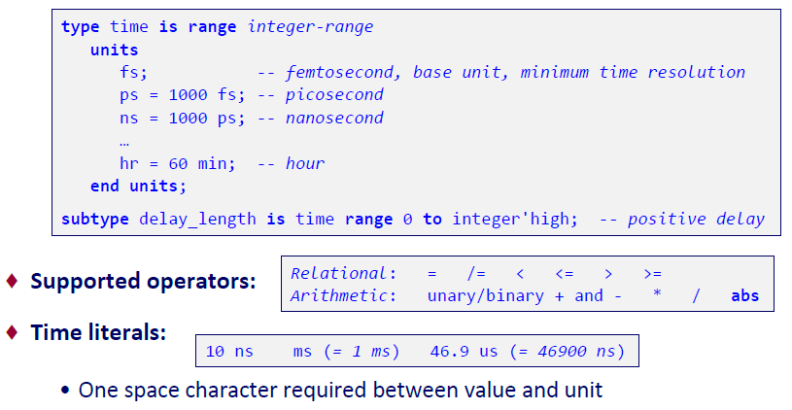
Time Representation: Type time

Slide 23
Arrays
An Array of type BIT is called a BIT_VECTOR
signal MYSIG : IN BIT_VECTOR( 0 to 3);
An Array of type STD_LOGIC is called a STD_LOGIC_VECTOR
signal yourSIG : OUT STD_LOGIC_VECTOR( 31 downto 0);
A STRING is a character array
constant GREETING: STRING := “Hello!”;

Slide 24
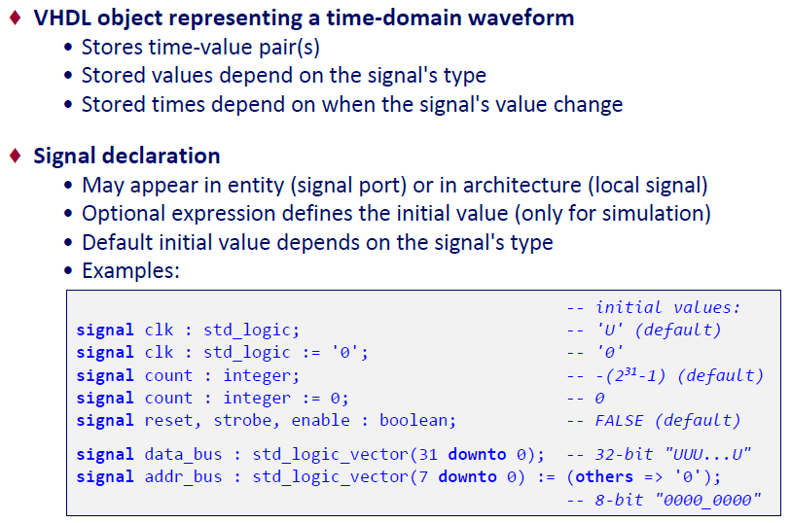
Signal

Slide 25
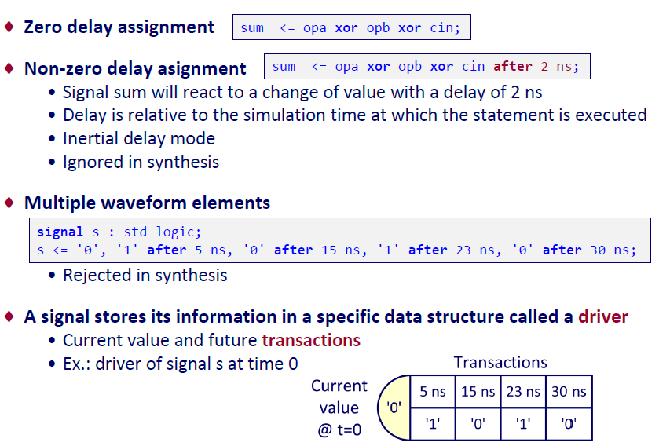
Signal Assignment Statement

Slide 26
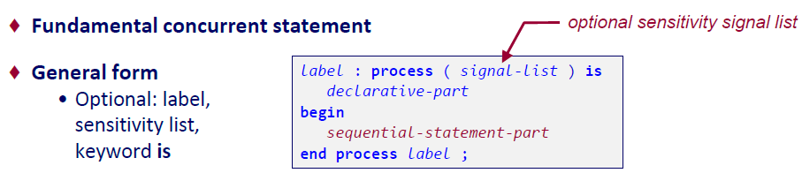
Process Statement
entity AND_OR_XOR is port (A,B : in bit; Z_OR, Z_AND, Z_XOR : out bit); end AND_OR_XOR; architecture RTL of AND_OR_XOR is begin A_O_X: process (A, B) begin Z_OR <= A or B; Z_AND <= A and B; Z_XOR <= A xor B; end process A_O_X ; end RTL;
Contains sequentially executed statements
Only within an architecture
Several processes run concurrently
Execution is suspended either via
sensitivity list (contains trigger signals), or
wait-statements
Signal values don’t change until suspension

Slide 27
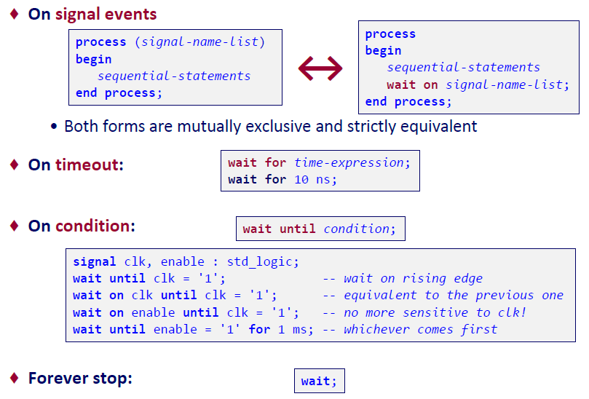
Process Activation Control

Slide 28
Process
ابزارهاي سنتز معمولاً ليست حساسيت را ناديده مي گيرند
براي مدارهاي ترکيبي همة وروديها بايد در ليست قرار گيرند تا نتيجة شبيه سازي قبل از سنتز با سخت افزار سنتز شده مطابقت داشته باشد.
براي مدارهاي ترتيبي، فقط clock و وروديهاي آسنکرون (reset, preset) در ليست قرار گيرند.

Slide 29
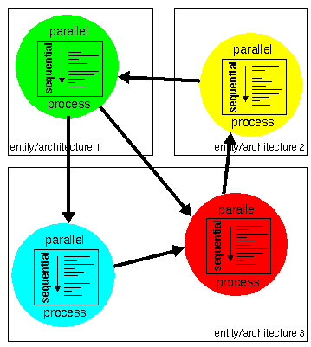
VHDL Communication Model
Processes are concurrent statements
Several processes
run in parallel
linked by signals in the sensitivity list
Link to processes of other entity/architecture pairs via entity interface

Slide 30
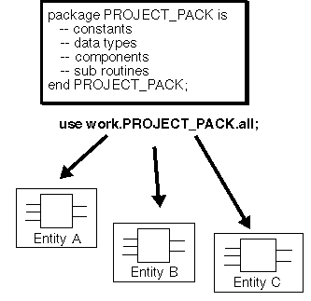
Packages
Collection of definitions, datatypes, subprograms
Reference made by the design team
Any changes are known to the team immediately
same data types ("downto vs. to")
extended functions for all
clearing errors for all

Slide 31
Packages
پکيجها در دو بخش نوشته مي شوند:
Package Header: شامل اعلان subprogram prototypeها، data typeها، ...
Package Body: شامل پياده سازي subprogramها
کامپايل را آسان مي کند: فقط header بايد خوانده شود تا تطبيق کد VHDL جاري با تعاريف اعلانهاي قبلي مشخص شود.

Slide 32
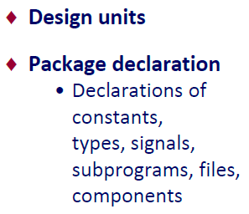
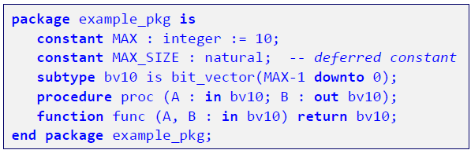
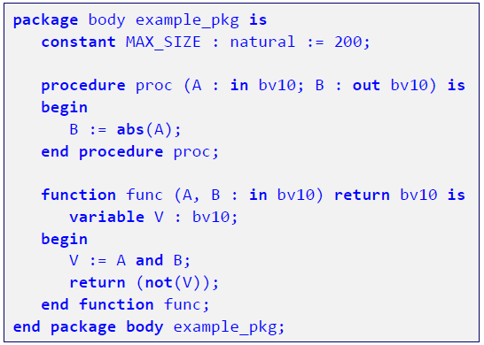

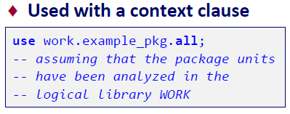
Package Declaration & Body

Slide 33
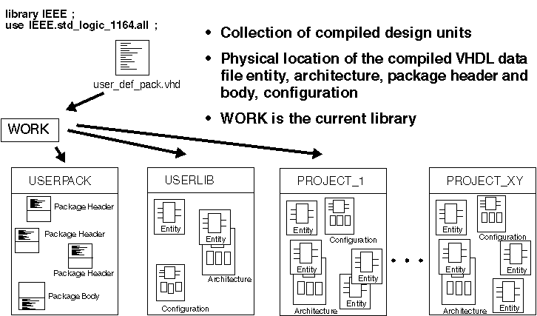
Library
:

Slide 34
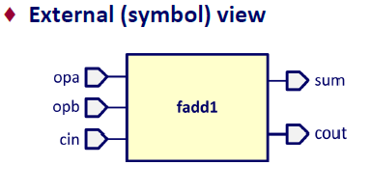
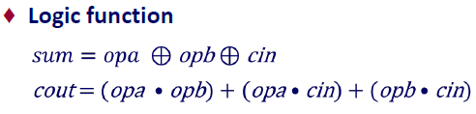
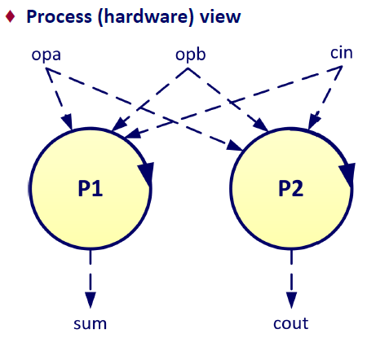
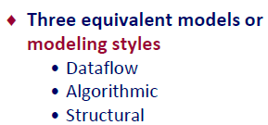
Modeling Combinational Logic: 1-Bit Full Adder

Slide 35
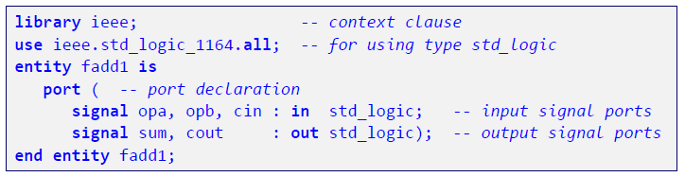
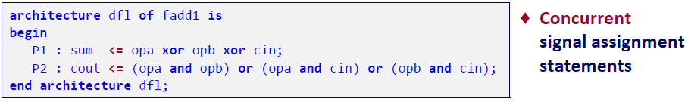
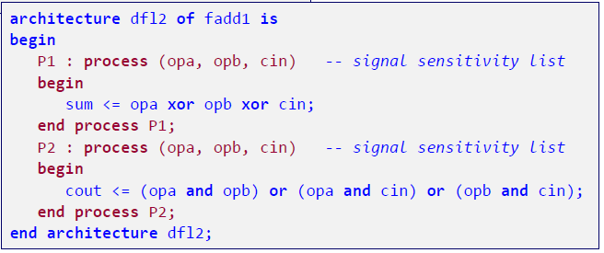

1-Bit Full Adder: Dataflow Models

